Slide 1




HOPE TO SKILL
Lecture 29
Autoencoders
In Deep Learning
Artificial Intelligence Advance Course

Slide 2



Dedicated to my late Teacher, a beacon of Knowledge.
Your Guidance shaped me; now I shape others through
a free course.
YOUR LEGACY LIVES ON!

Slide 3




AI INSTRUCTORS
Dr.Irfan Malik
Dr.Sheraz Naseer
Dr.Shazia Saqib
M.Haris Tariq

Slide 4
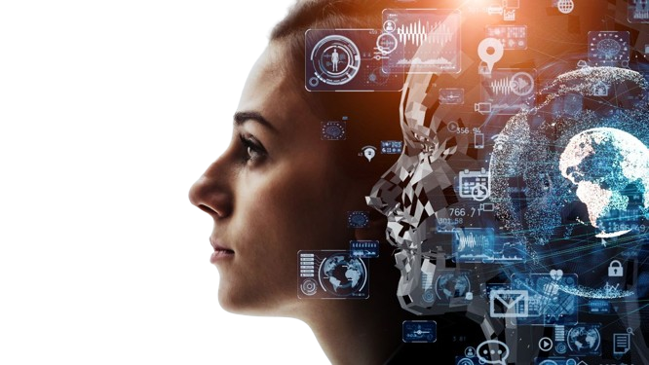


Previous Lecture Topics
Convolutional Neural Networks (CNN)
01
Convolution
02
Kernels
03
Stride
04
Pooling
05
Padding

Slide 5

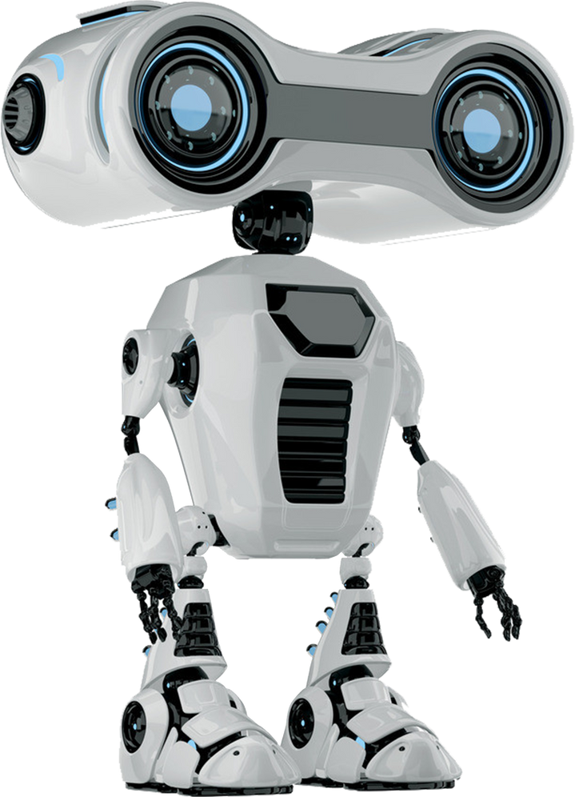

Outline
Applications of CNN
AutoEncoders
Introduction
Architecture
Encoder
Feature space
Decoder

Slide 6

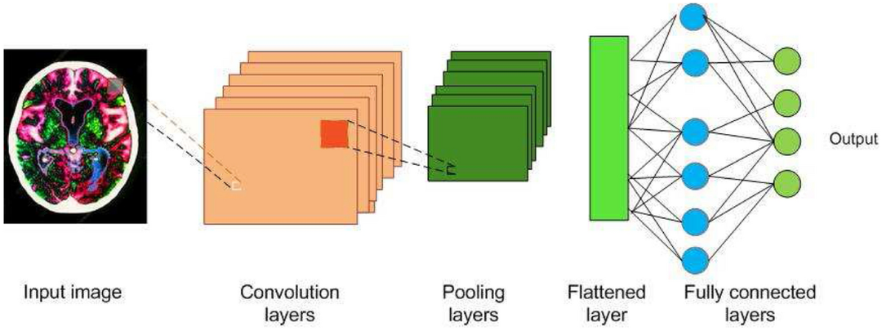
Applications of CNN
01
Image Classification
02
Image Segmentation
03
Object Detection
04
Facial Recognition
05
Gesture Recognition

Slide 7
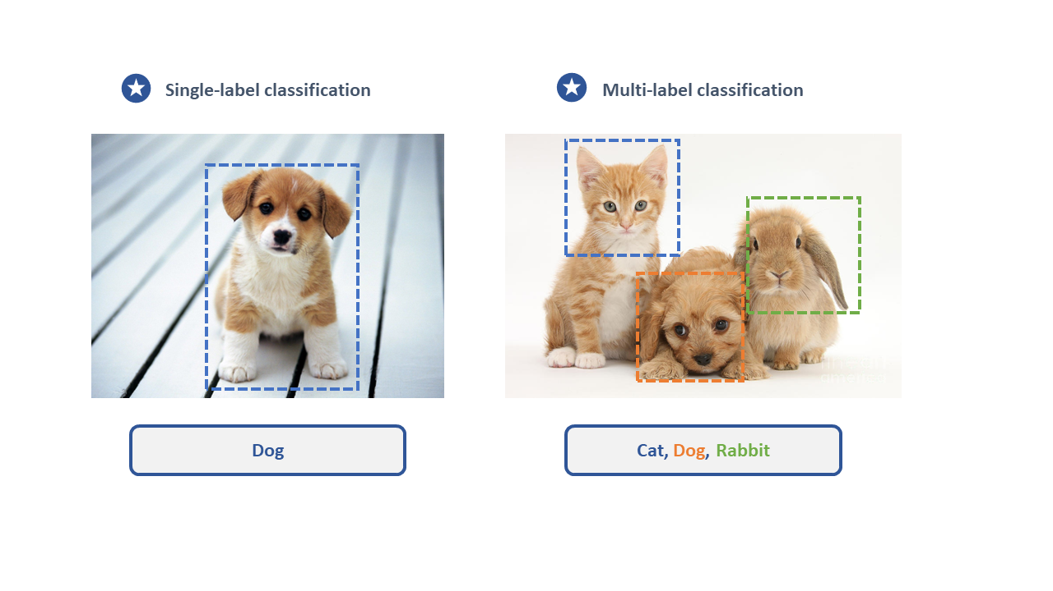
Image Classification

Slide 8
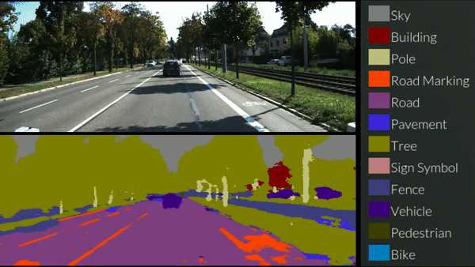
Image Segmentation

Slide 9

Object Detection

Slide 10
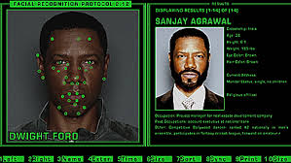
Face Recognition

Slide 11
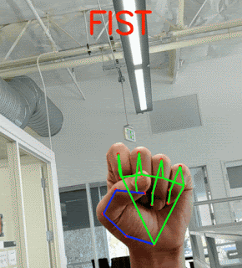
Gesture Recognition

Slide 12

Why CNNs Struggle?
CNNs require labeled data for training, which limits their applicability in scenarios where labeled data is scarce or expensive to obtain.

Slide 13
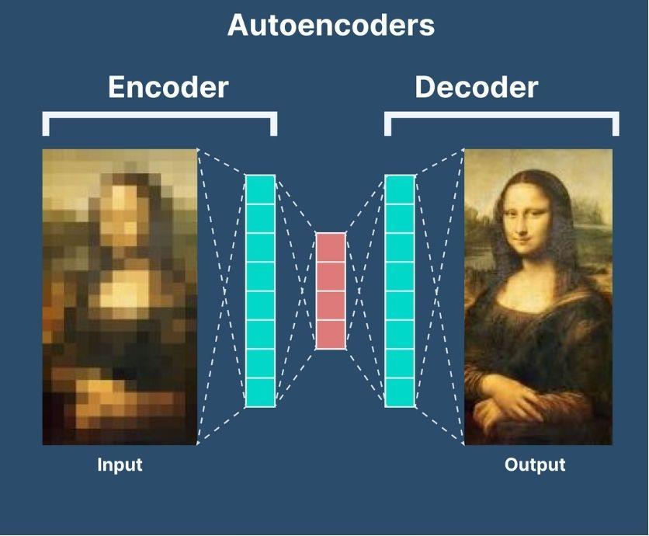
What are Autoencoders?
A type of neural network designed for data compression, anomaly detection, dimensionality reduction and feature learning.

Slide 14
What are Autoencoders?
Primary Goal:
To encode data into a compact representation and then decode it for reconstruction.

Slide 15
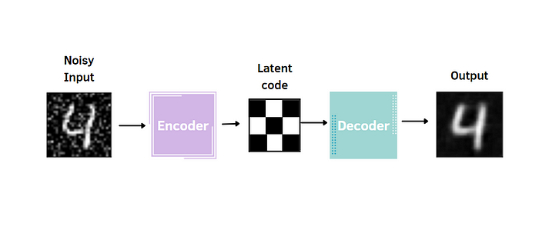
Encoders
Converts original data into a secret code.
Uses rules or transformations to hide the message.

Slide 16
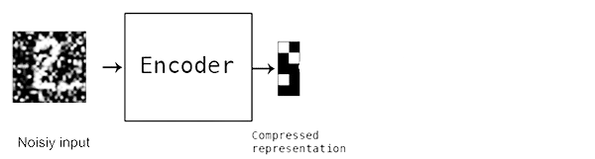
Encoders
The encoder is like a detective that learns to capture the most important features of an image or data.
It's the first part of the autoencoder and is responsible for compressing the input data.

Slide 17
How does the Encoder work?
Imagine an encoder as a funnel that
squeezes a big picture into a smaller
representation.
It transforms the input data (e.g., an image)
into a compact form called the latent
space or encoding.

Slide 18
Encoding Process
Step: 1
The input data, such as an image, is fed into the encoder.
Step: 2
The encoder consists of layers of neurons that learn patterns and features in the data.
Step: 3
These patterns are combined and transformed into a compact representation in the Low Dimensional Space (latent Space).

Slide 19
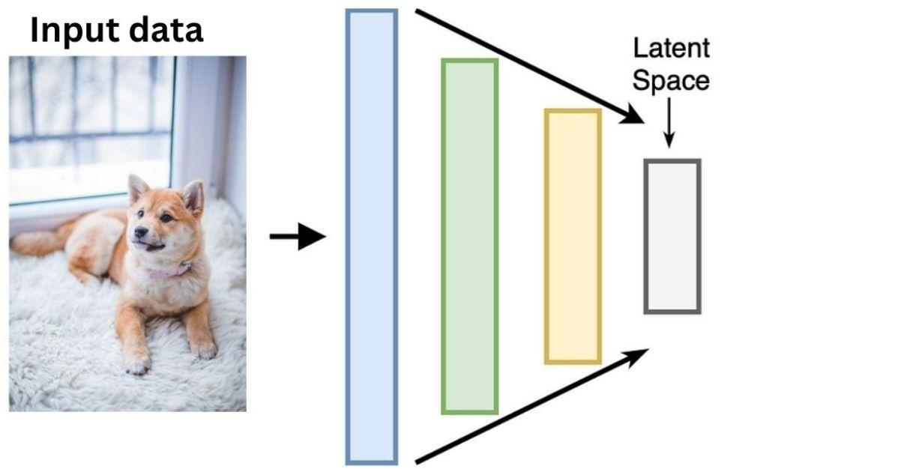
Encoding Process

Slide 20
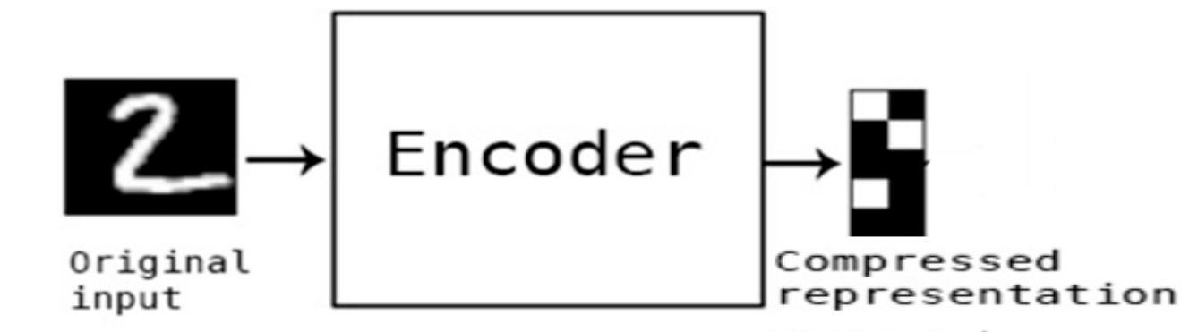
Why Encoders are Important?
Data Compression: The encoding is much smaller than the original data, making it efficient to store and transmit.
Feature Extraction: The encoder learns to extract valuable information, which can be used for various tasks.

Slide 21
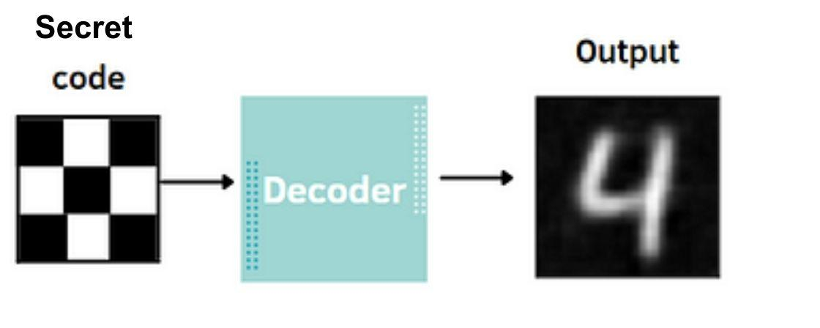
Decoders
Reverts the secret code back to the original data.
Understands the rules to reverse the encoding.
Enables understanding of the hidden message

Slide 22
Decoders
The decoder is like an artist that takes the compact representation (encoding) from the encoder and recreates the original data.
It's the second part of the autoencoder and responsible for generating output from the encoding.

Slide 23
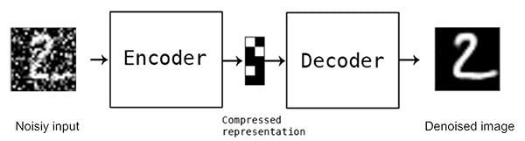
How does the Decoder Work?
Imagine a decoder as a reverse funnel that expands the compact representation back into a full image or data.

Slide 24
How does the Decoder Work?
It transforms the encoding from the latent space back into a reconstructed output enabling the decoder network to reconstruct the original input as closely as possible.

Slide 25
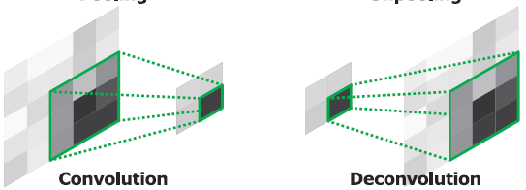
Deconvolution
Deconvolution takes the compressed feature maps from the encoder and expands their spatial dimensions.

Slide 26
Deconvolution
It does this by learning upsampling filters that increase the resolution of the fe﻿ature maps, allowing the decoder to progressively build a more detailed representation.

Slide 27
Decoding Process
Step: 1
The encoded data (latent space representation) is fed into the decoder.
Step: 2
The decoder consists of layers that learn to reverse the compression process by generating features and patterns.
Step: 3
These generated features are combined to reconstruct the original data.

Slide 28
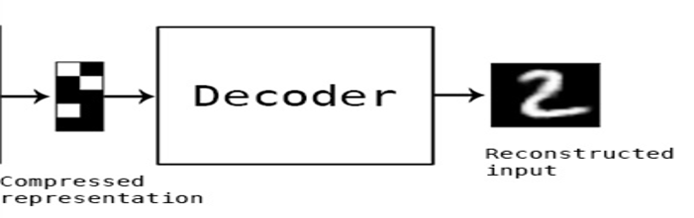
Recreating Original Data
The decoder's goal is to recreate
data as close to the original input
as possible.
It uses the knowledge it gained
from the encoder to generate
meaningful features.

Slide 29
Why Decoders are Important?
Data Reconstruction:
The decoder's job is to bring back the data's original form from the compressed encoding.

Slide 30
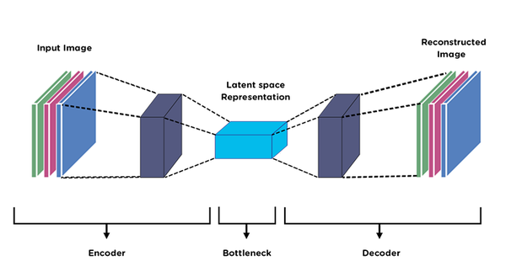
Anatomy of an Autoencoder
Components: Encoder, Latent Space/Bottleneck, Decoder.
Autoencoders aim to minimize the difference between the input and the reconstructed output.

Slide 31
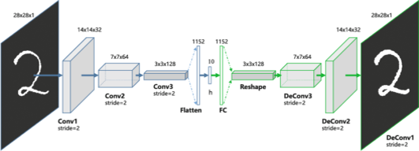
Anatomy of an Autoencoder

Slide 32

Previous Lec: 28
click Here
Next Lec:30
click Here
Quiz
click Here

Slide 33


Home Work
In which scenarios do autoencoders work well, and in which scenarios do they not?

